Slide 1
OOP
Abstraction and Interface

Slide 2
Abstraction
Is a process of hiding the implementation details and showing only functionality to the user
Lets you focus on what the object does instead of how it does it

Slide 3
Abstract Class in Java
A class which is declared as abstract is known as an abstract class.
It can have abstract and non-abstract methods.
It needs to be extended and its method implemented.
It cannot be instantiated.

Slide 4
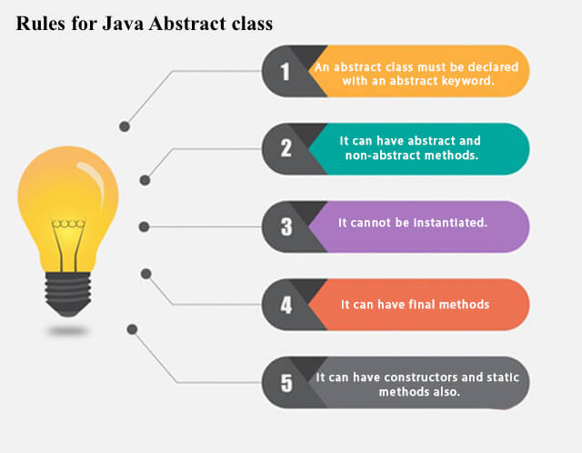
Abstract Class in Java

Slide 5
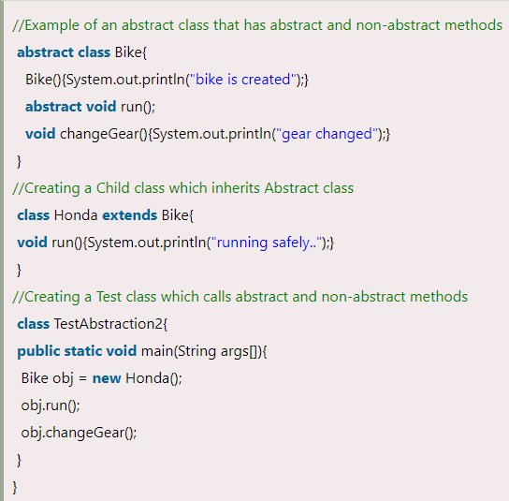
Example of Abstract Class

Slide 6
Interface
The interface in Java is a mechanism to achieve abstraction. There can be only abstract methods in the Java interface, not method body. It is used to achieve abstraction and multiple inheritance in Java.
It cannot be instantiated just like the abstract class.

Slide 7
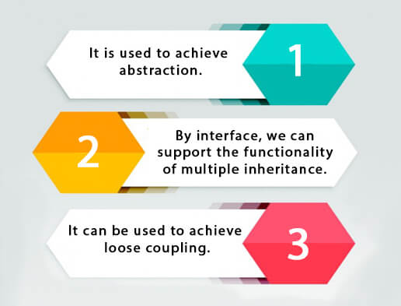
Interface

Slide 8
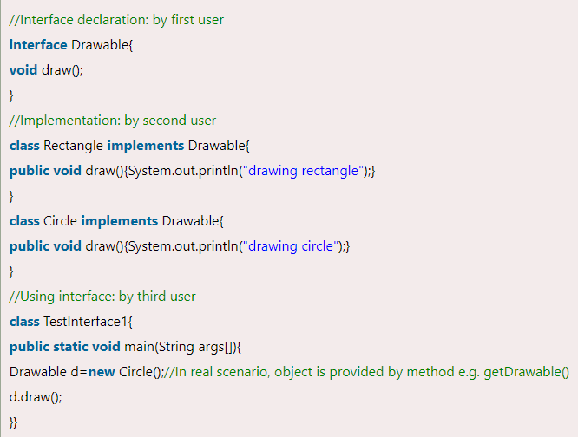
Example of Interface

